Slide 1
Manufacturer of Broadband Microwave & Millimeter Wave Components
Ver.2412

Slide 2
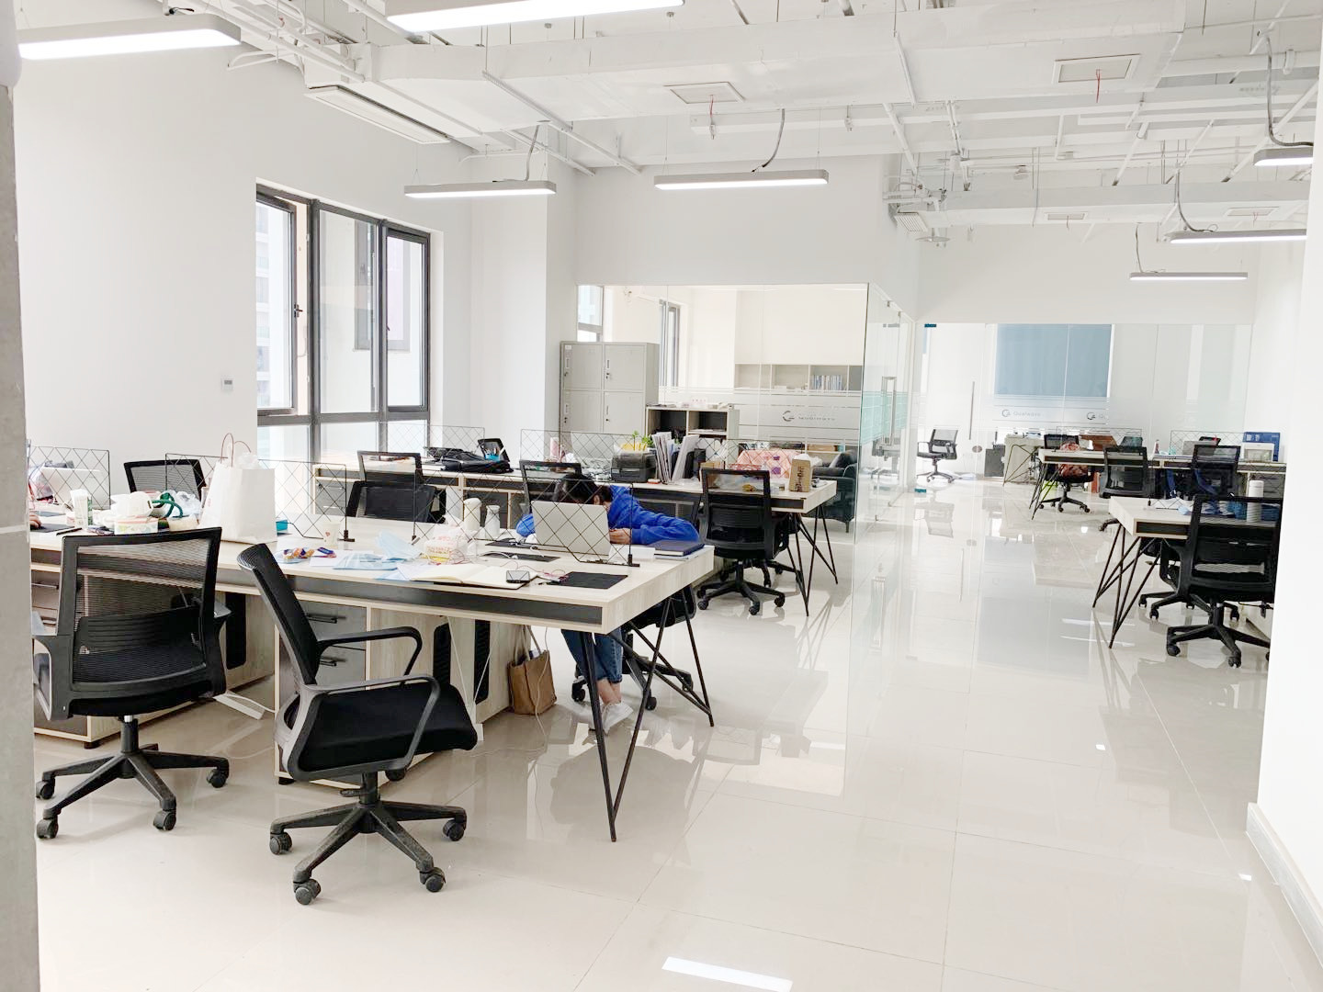
Company Production
Freflex is a privately-owned company based in Chengdu, China. We design,manufacture and market both active and passive components up to 330GHz all over the world. Our products are mainly used in Industry, Defense, Aviatronic, Telecom, Satcom, Test and Measurement application.

Slide 3
R&D
Our company has a total of 68 skilled staffs, including 10 engineers, most of whom have over 14 years’ experience in this industry, and 35 well-trained workers.

Slide 4
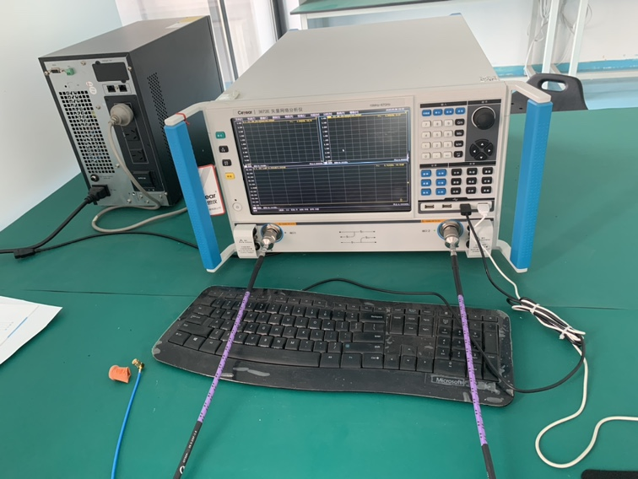
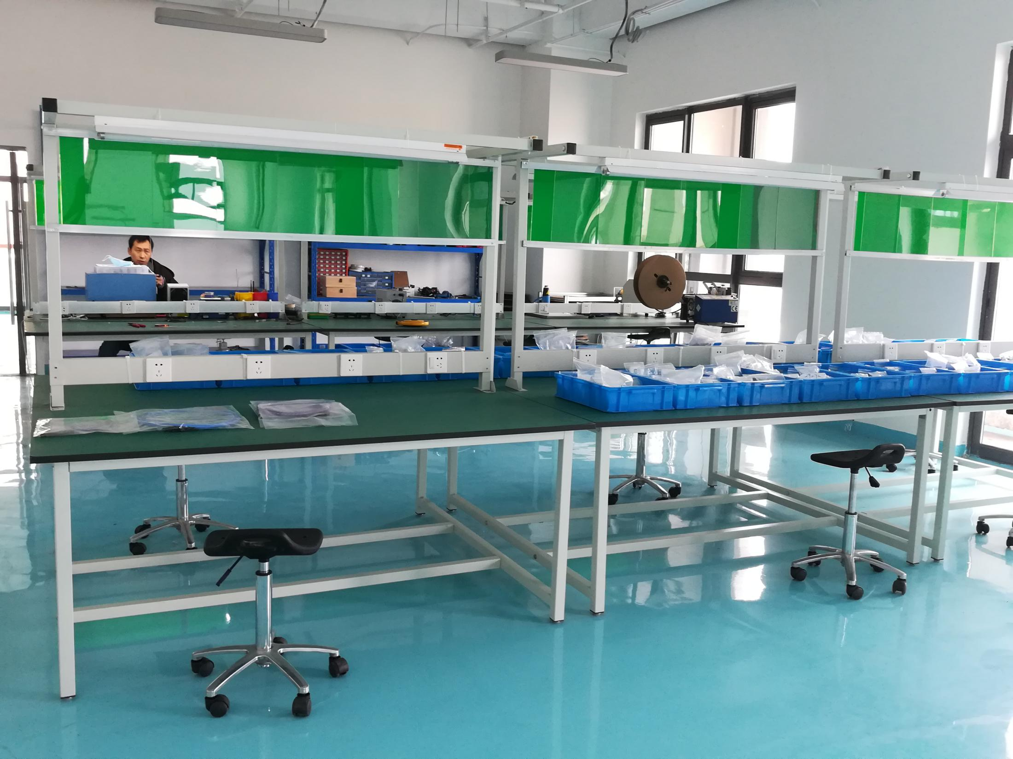
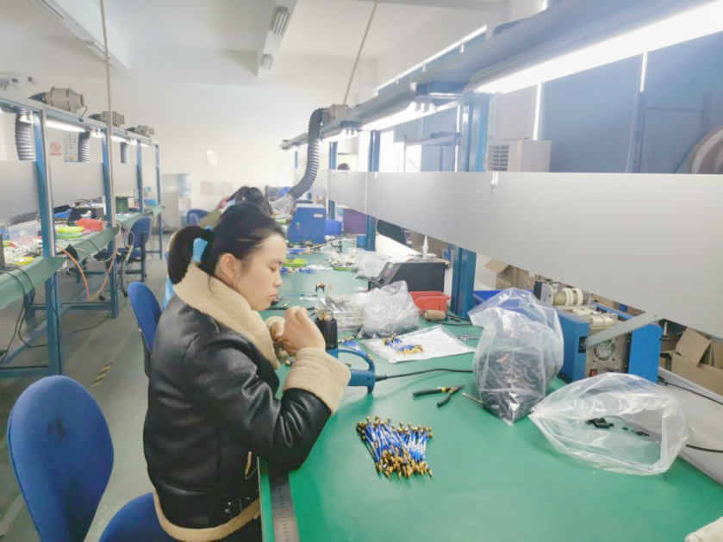
Factory
Our company is equipped with 67GHz vector network analyzers, signal sources, spectrum analyzers, power meters, oscilloscopes, welding platforms, resistance and voltage withstand test instruments, high and low temperature test systems and other research and development, production and testing equipments. Our quality management system has been successfully registered for GB/T19001-2016/ISO9001:2015.

Slide 5
Customers

Slide 6
Features
FOCUS
DC~330GHz Microwave & MM-wave Components
Design & Manufacture Active / Passive Components
CAPABILITY
QUALITY
GB/T 19001-2016/ ISO 9001:2015 Certificate
ADVANTAGE
Fast Delivery (0~4weeks) & Competitive Price
SERVICE
Customization + Fast Response

Slide 7
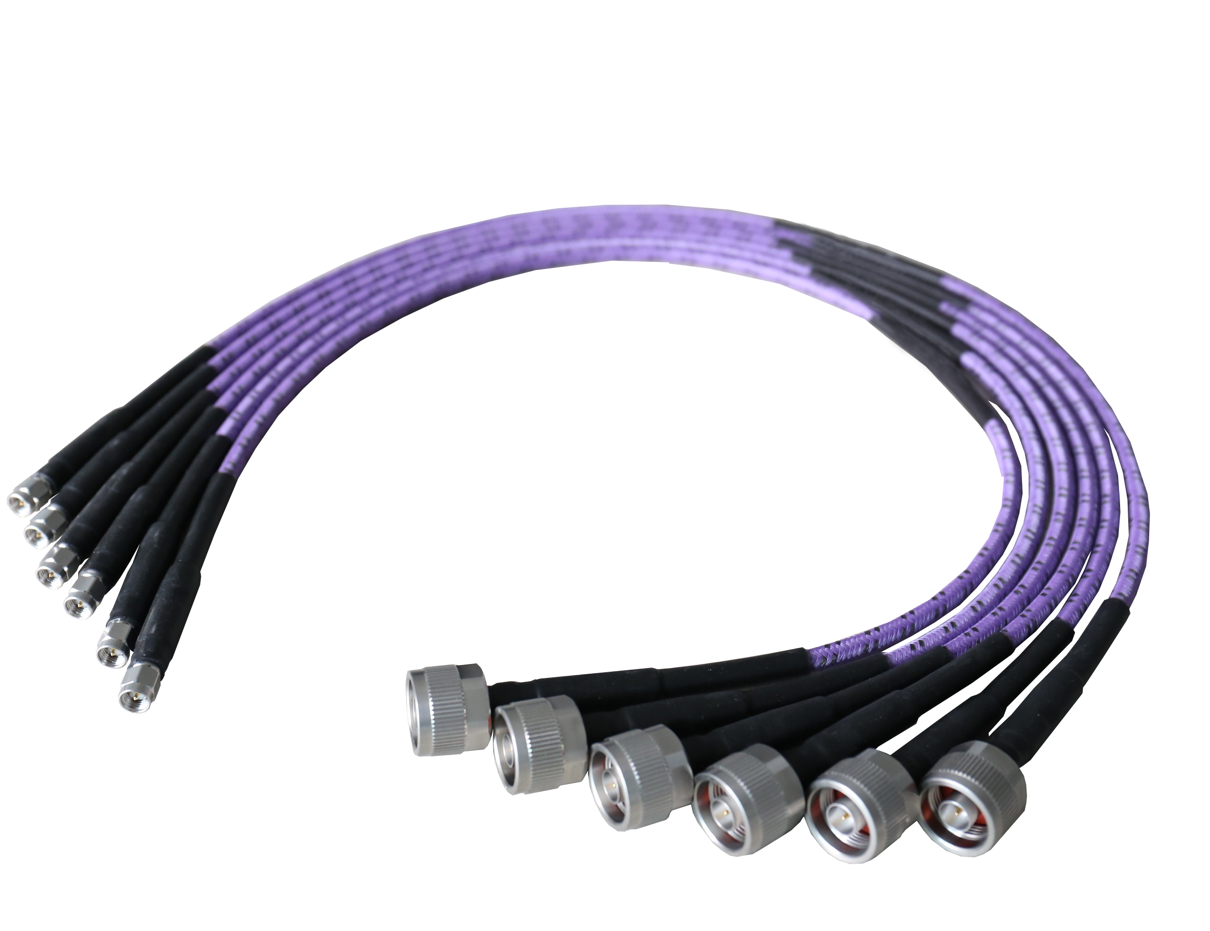
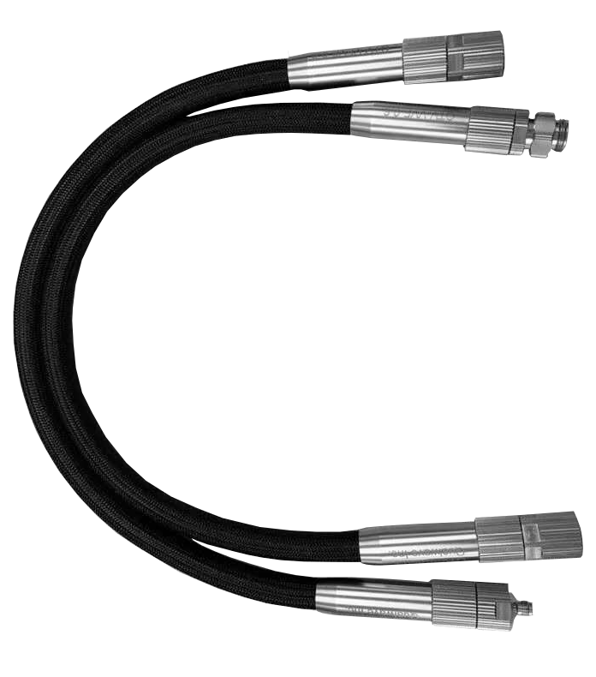
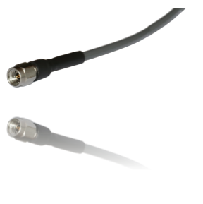
Cables & Assemblies
FT Series
FTV Series
FA Series
Test Cable QT Series
Up to 110GHz
Long Bending Life
Phase & Loss Stable
Long Flex Life
Up to 67GHz
NMD Connector
Ultra Low Loss
Phase Stable
IL: 2.18dB/m@40GHz
Multi-Channel Cable Assemblies available

Slide 8
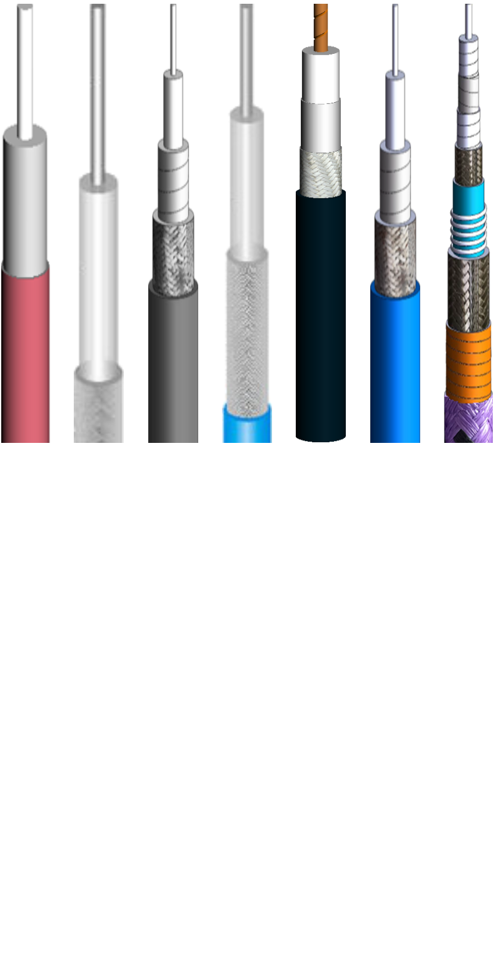
Cables & Assemblies
FH Series: Flex. 40GHz, 086/141
FE Series: Semi-Rigid, 40GHz, 086/141
FD Series: Semi-Flex, 40GHz, 086/141
FR Series: Wireless Communication/LMR Cable
RG Series: RG58, RG142, RG174, RG178, RG304, RG316(D), RG400...
FCE series: Cryogenic cable (-268 deg.)

Slide 9
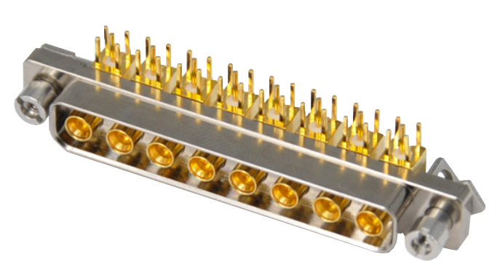
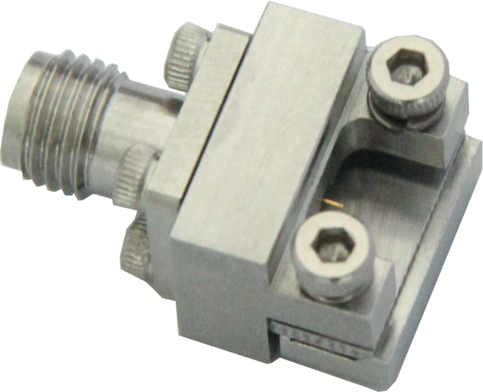
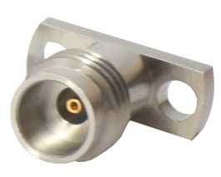
Connectors
PCB Connector
End/Vertical Launch Connector
Cable Connector
Multi-channel connector
Accessories
* DC-110GHz | Customization is available
Connectors
Connectors
1.00
mm
1.85
mm
2.4
mm
2.92
mm
3.5
mm
7/16
(DIN)
N
SC
TNC
SSMP
SSMA
SMA
BNC
SMP

Slide 10
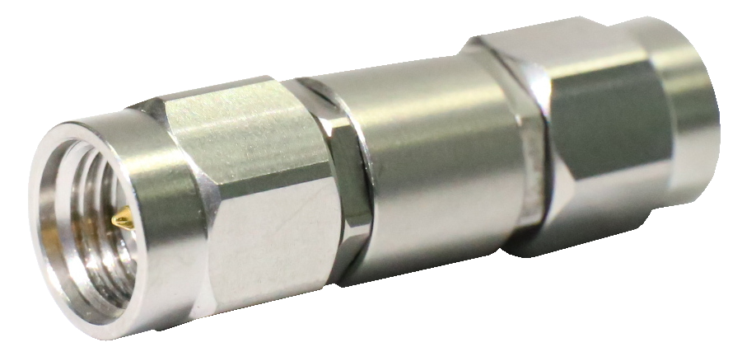
Coaxial Adapters
DC-110GHz
VSWR<1.15@40GHz
Customization is available
FAK3-MM
* NMD adapter is avaible
Connectors
1.00
mm
1.85
mm
2.4
mm
2.92
mm
3.5
mm
7/16
(DIN)
N
SC
TNC
SSMP
SSMA
SMA
BNC
SMP

Slide 11
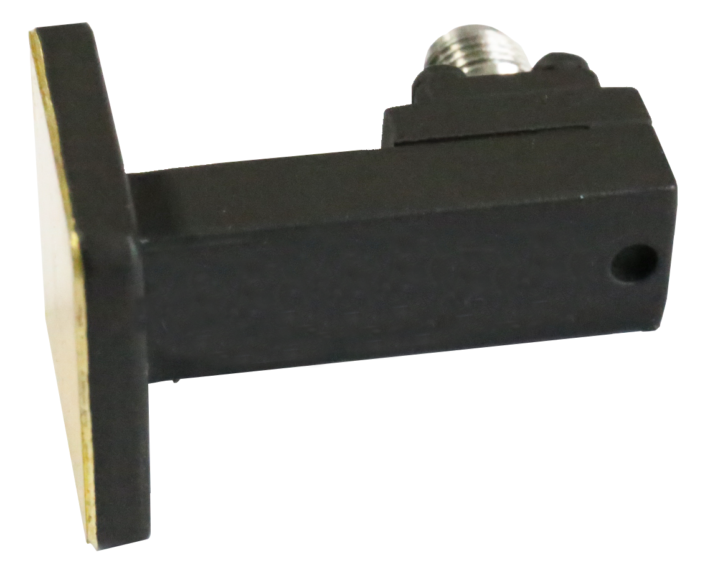
Waveguide Products
Flexible Waveguide
Waveguide Bends
Pressure Windows
Waveguide Twists
Waveguide Transitions
Waveguide Straight Sections
Magic Tee
Waveguide to Coaxial adapters
Waveguide Size
WR1150 to WR10

Slide 12
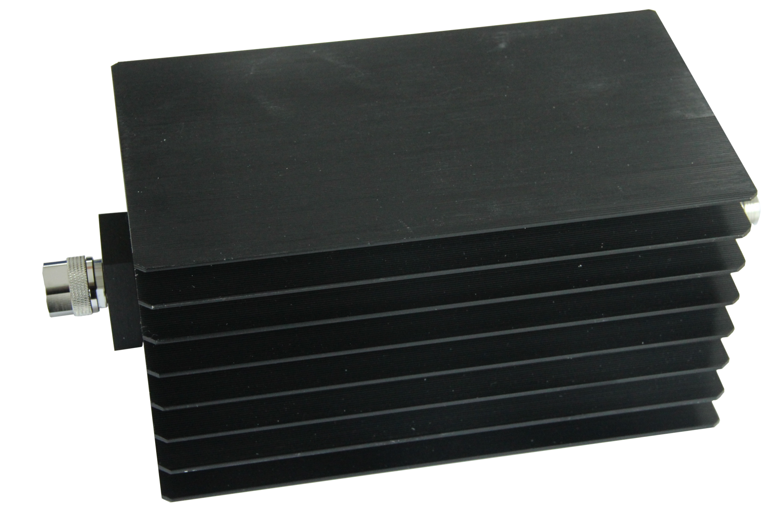
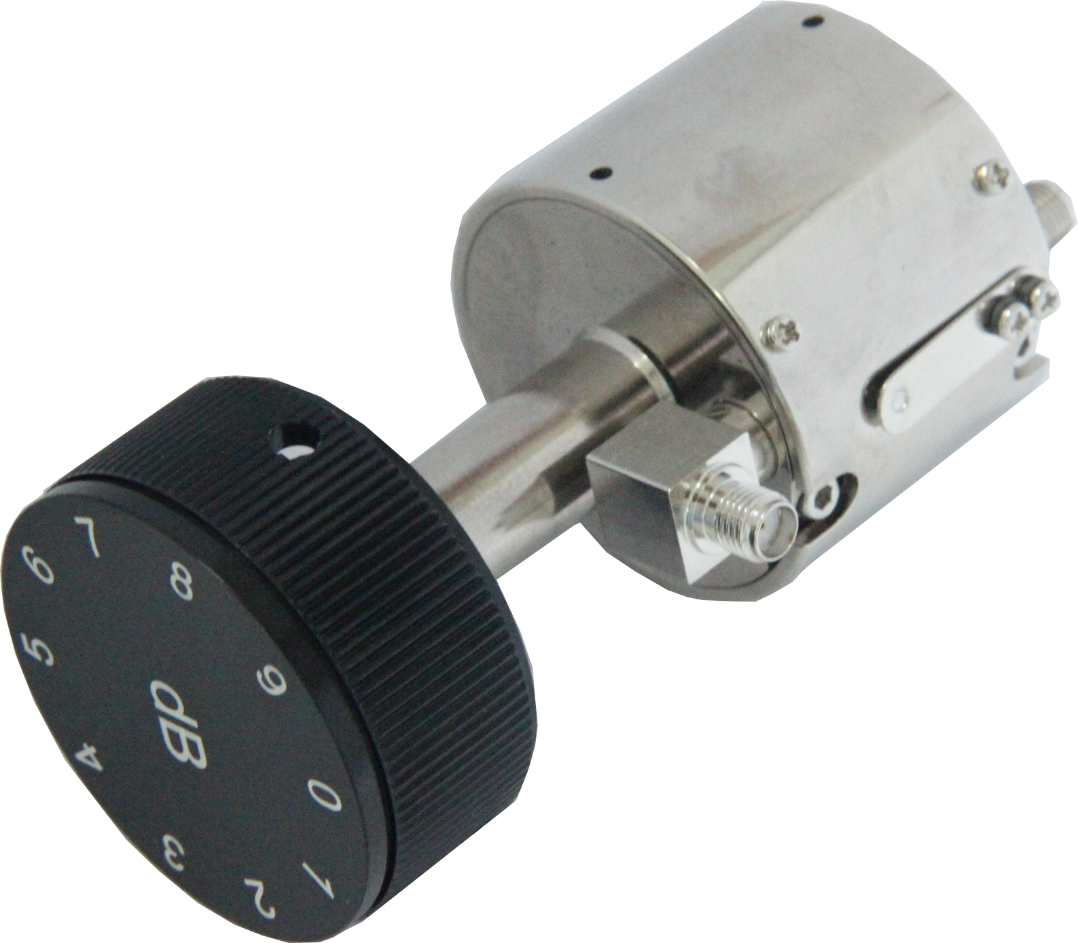
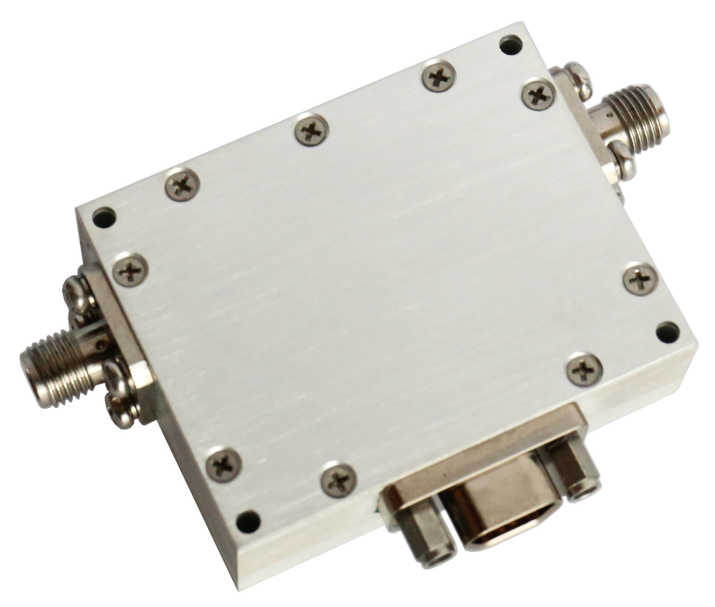
Attenuators
Fixed Attenuators: Up to 110GHz | 600W @18GHz
Rotary Stepped Attenuators: Up to 40GHz | High Accuracy
Continuously Variable Attenuators: DC-18GHz/0-40dB/10W
Digitally controlled Attenuators:
40GHz | 0.25dB Step | Customization Available
Voltage Controlled Attenuators：0.1-40GHz
Attenuators

Slide 13
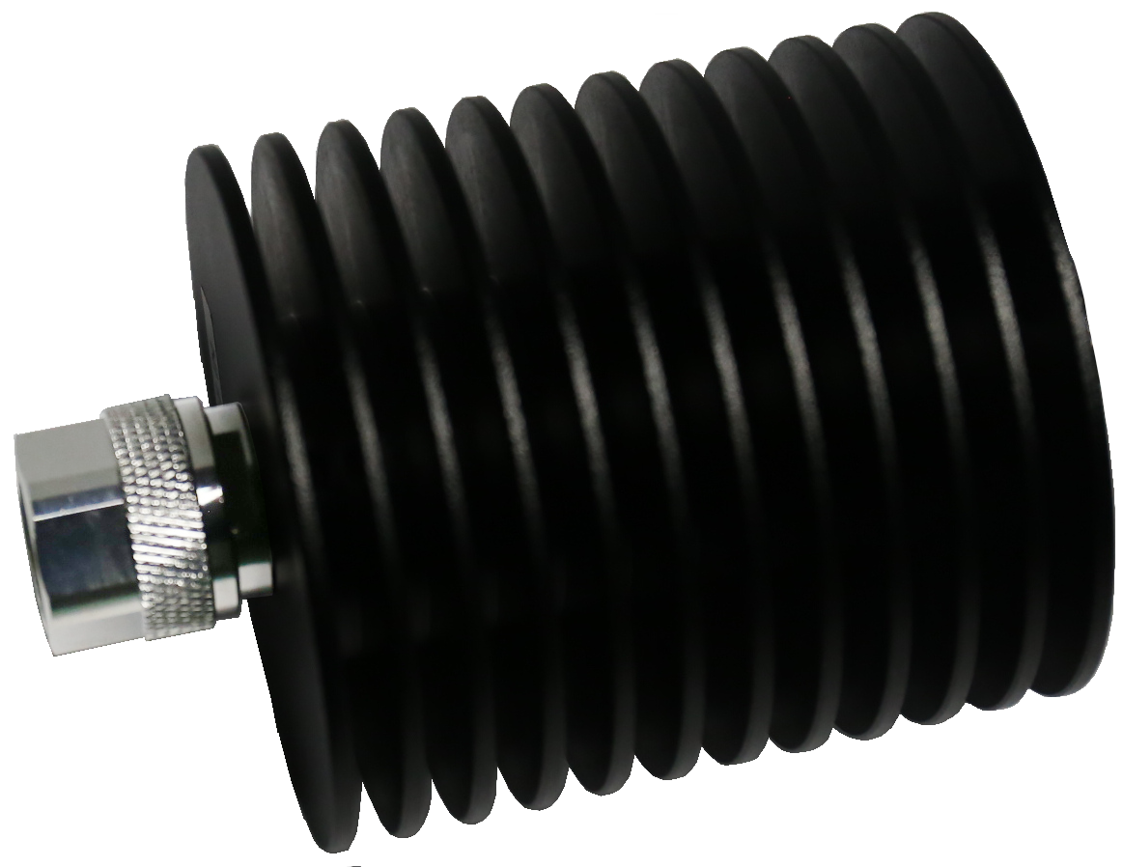
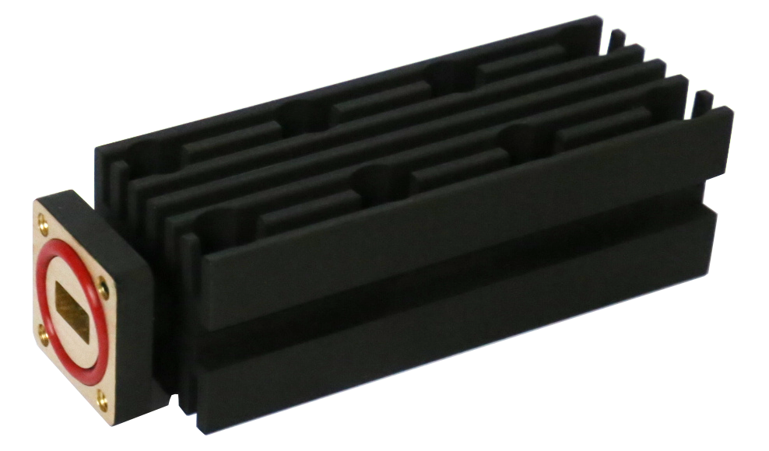
Terminations
Coaxial Terminations:
Up to110GHz | Up to 600W@18GHz
Waveguide Terminations: 1.13~75.8GHz
WR-1150 ~ WR-10 | 5W ~ 2500W
FCT18K1 (18GHz, 100W)
Terminations
FWT3440 (WR34, 40W)

Slide 14
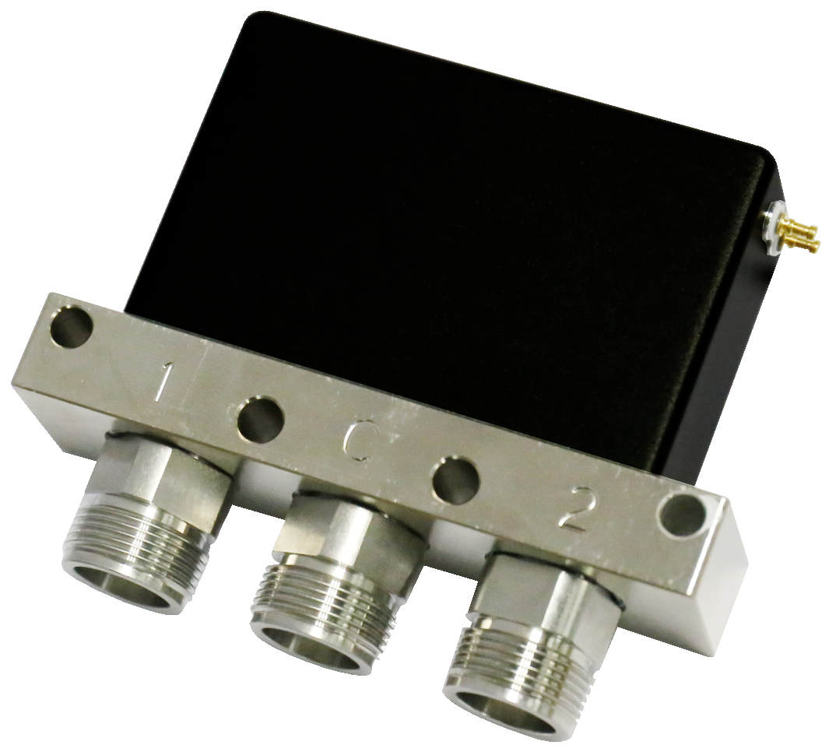
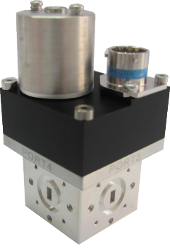
Switches
Pin Diode Switches:
40GHz | 50nS Switching Time | Customization Available
Coaxial Switches:
110GHz | SPDT-SP12T, DPDT, 2P3T | SP8T@40GHz
Extended Temperature: -45~+85 deg.
Waveguide Switches: 3.95~110GHz, WR-187 ~ WR-10
Surface Mount Relay Switches: DC~18GHz, Small Size.
Coaxial Switches

Slide 15
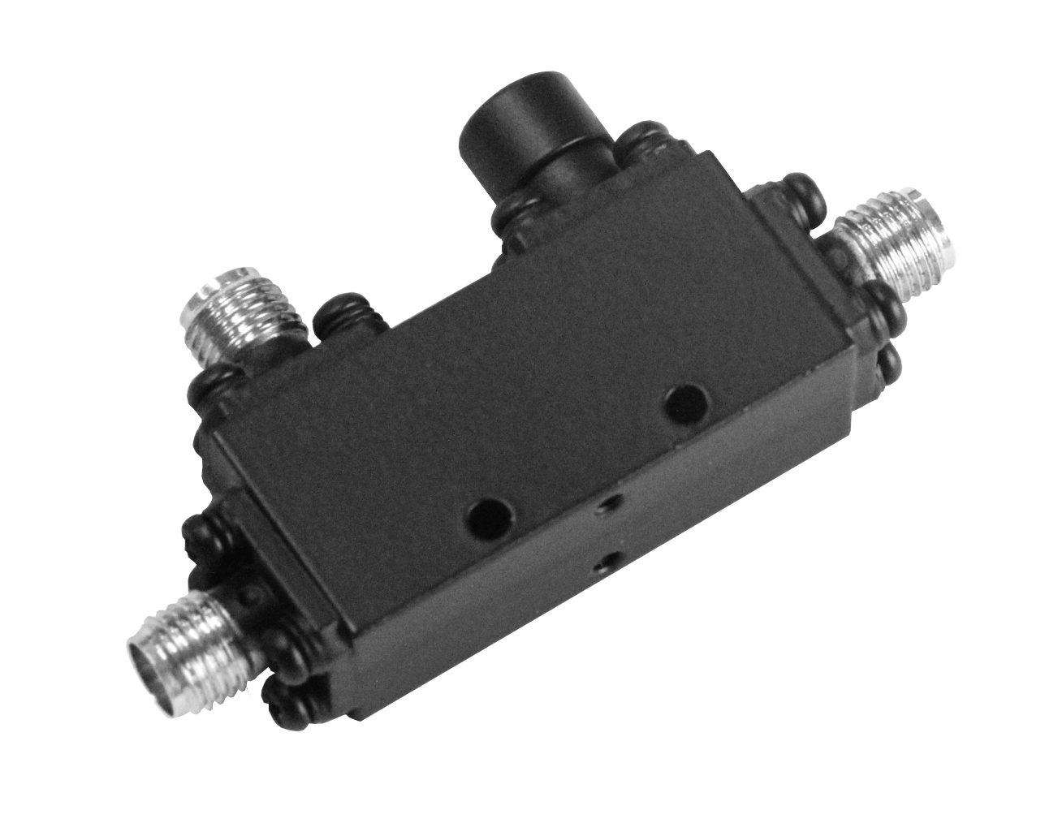
Couplers
Directional Couplers: up to 86GHz
90 Degree Hybrid Couplers: up to 40GHz
180 Degree Hybrid Couplers: up to 40GHz
Waveguide Couplers （broadwall,loop, crossguide）
Couplers

Slide 16
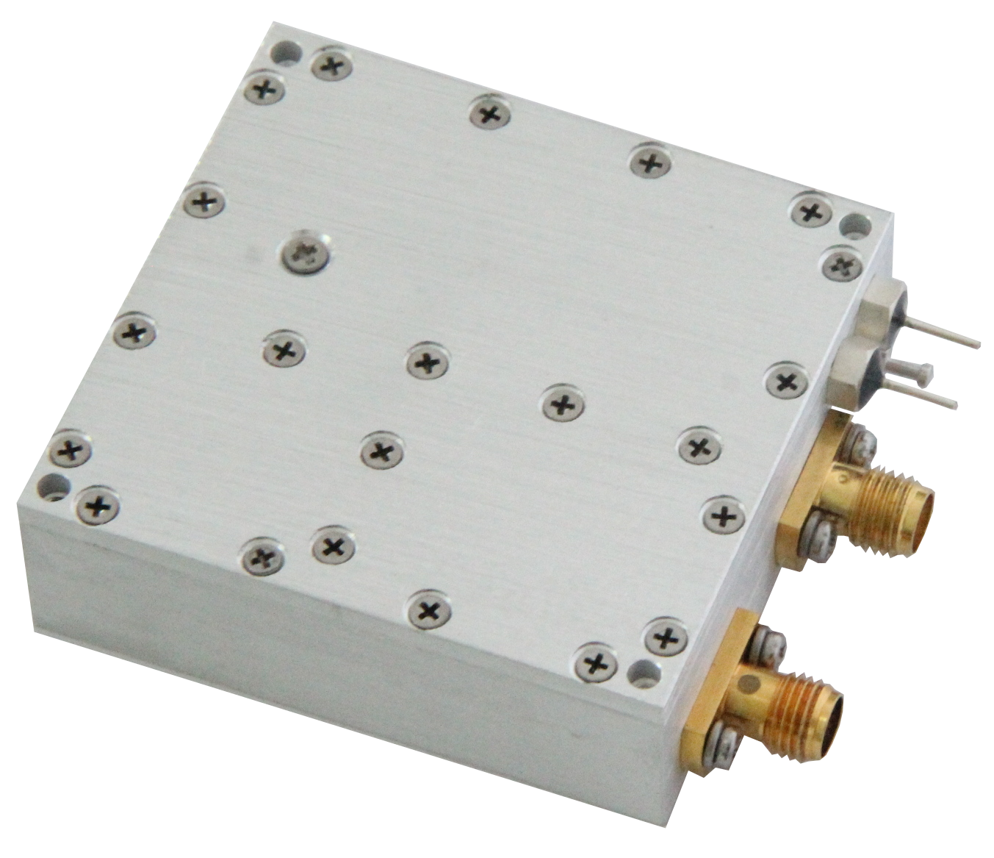
Frequency Sources
Freq.: 100MHz~40GHz
Reference: External/Internal
Power: 10dBm or higher
Phase Noise: -110dBc/Hz typical @1KHz Offset
Customization is available
No MOQ
Frequency Sources
Frequency Sources
Frequency Sources
DRO
DRO
DRO
VCO
VCO
PLXO
PLDRO
PLXO
PLDRO
PLDRO
PLVCO

Slide 17
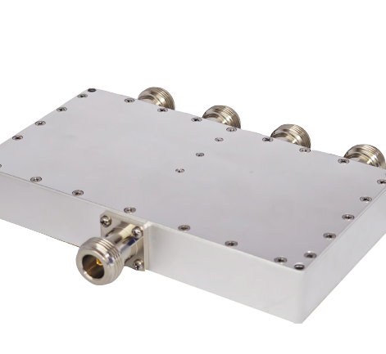
Power Dividers / Combiners
Frequency: DC~110GHz
Path: 2~52 ways
Isolation: 16~25 dB
Power up to 10KW
Amplitude Balance: ±0.2dB~±1dB
Phase Balance: ±2°~±8d°
Power Divider/ Combiner

Slide 18
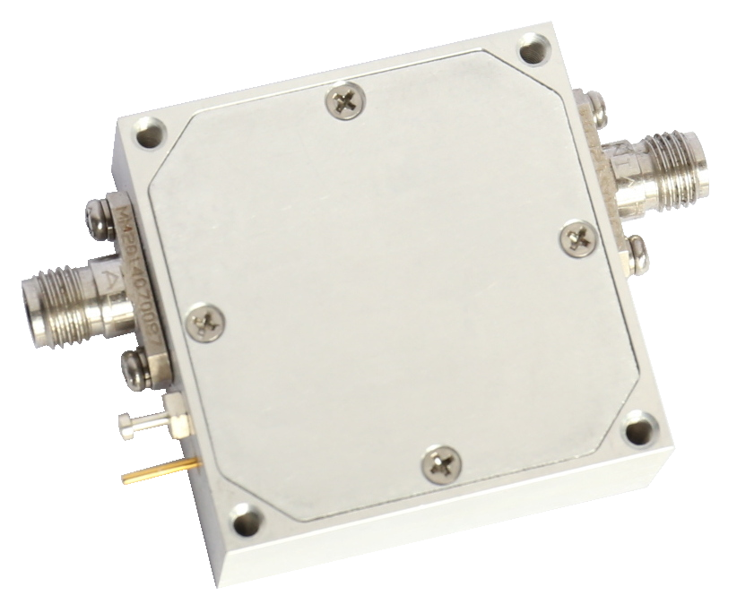
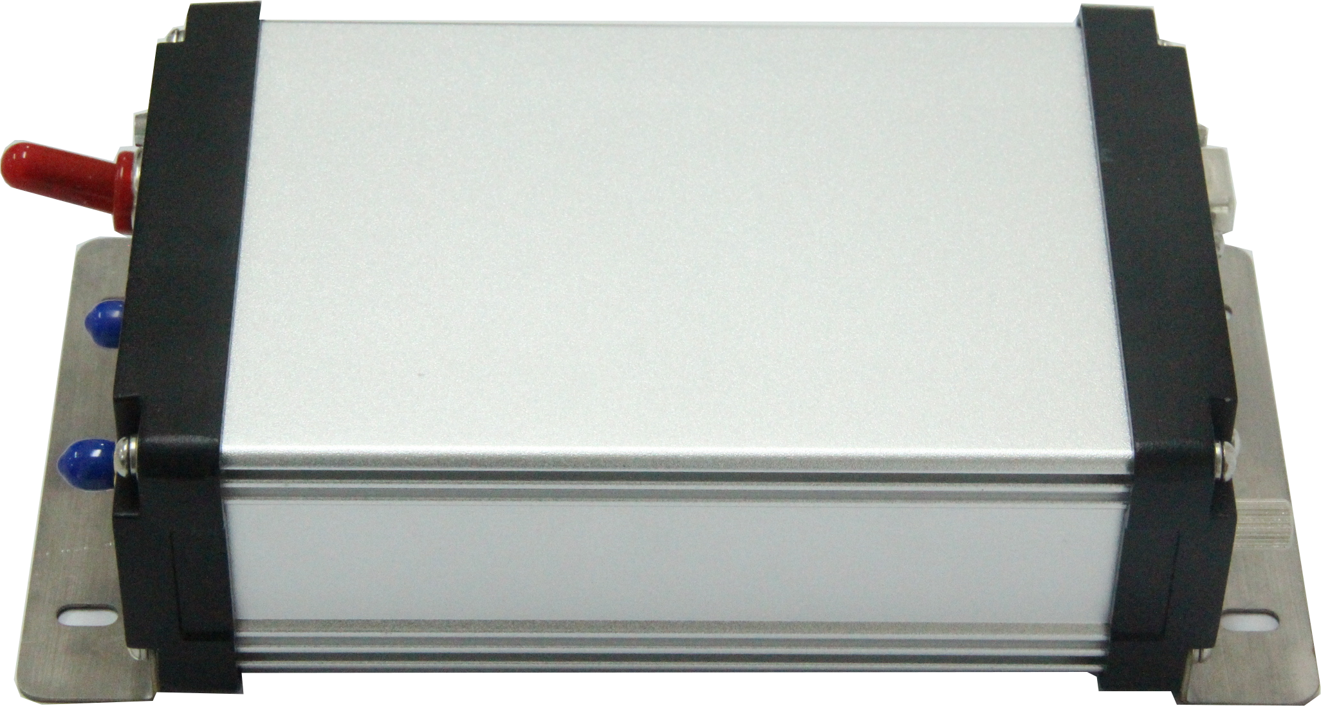
Amplifiers
Freq. 4KHz to 330GHz
Power up to 2000W
Noise figure: down to 0.5dB
Module & System available
PA Module
Power Amplifier & LNA
LNA Bench Top

Slide 19
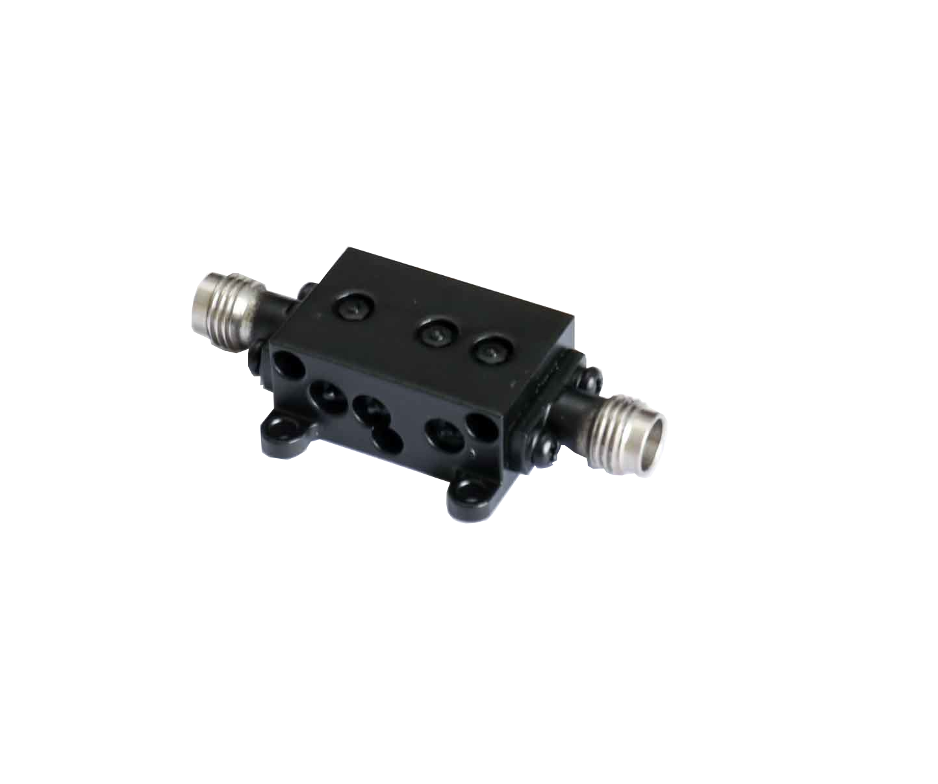
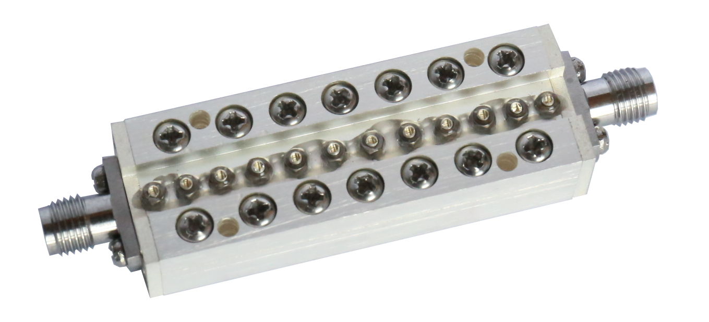
Filter
Freq.: Up to 110GHz
Stopband Attenuation: up to 90dB
Customization is available
Coaxial and waveguide
Filter
Band Pass
Band Pass
High Pass
High Pass
Low Pass
Band Reject

Slide 20
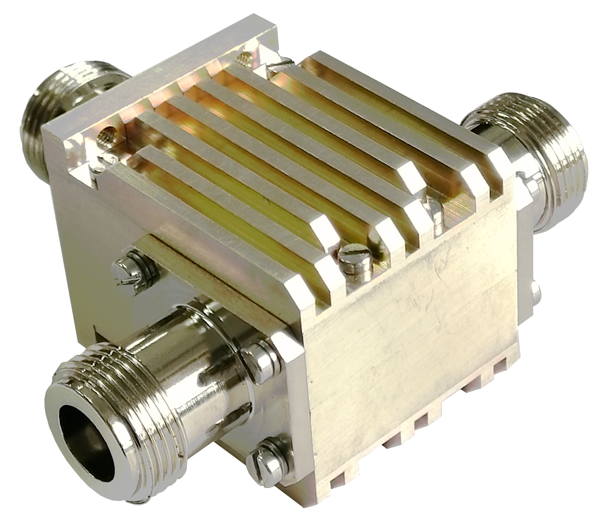
Circulators/Isolators
Freq.: 10MHz ~110GHz
Isolation: 16 ~ 50dB
Bandwidth: up to 4 Octaves
Insertion Loss: 0.3 ~ 1dB typical
Average Power: up to 1.5KW CW
Customization is available
Frequency Sources
Frequency Sources
Circulators/
Isolators
Coaxial
Drop-In
Surface Mount
Waveguide
Microstrip

Slide 21
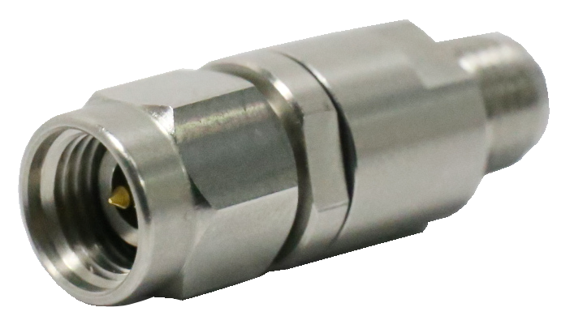
DC-Blocks
Freq. up to 110GHz
Voltage 25V, 50V
IL <0.9dB @ 67GHz
High Voltage available
Connector
1.0mm, 1.85mm, 2.4mm, SMP, SSMP, 2.92mm, SSMA, SMA, N,7/16, 4.3/10

Slide 22
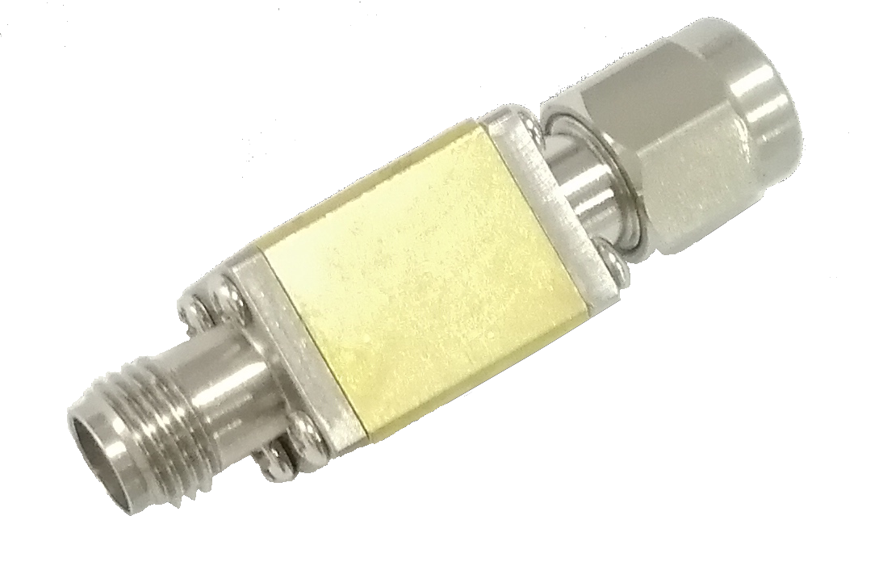
Detectors
Freq. : 10MHz ~ 110GHz
Sensitivity: 100~300 mV/mW
Polarity: Negative / Positive
Input Connector: 2.4mm, SMA, WR28~WR10
Output Connector: 2.92mm, SMA
Detectors
Coaxial Detectors
Waveguide Detectors

Slide 23
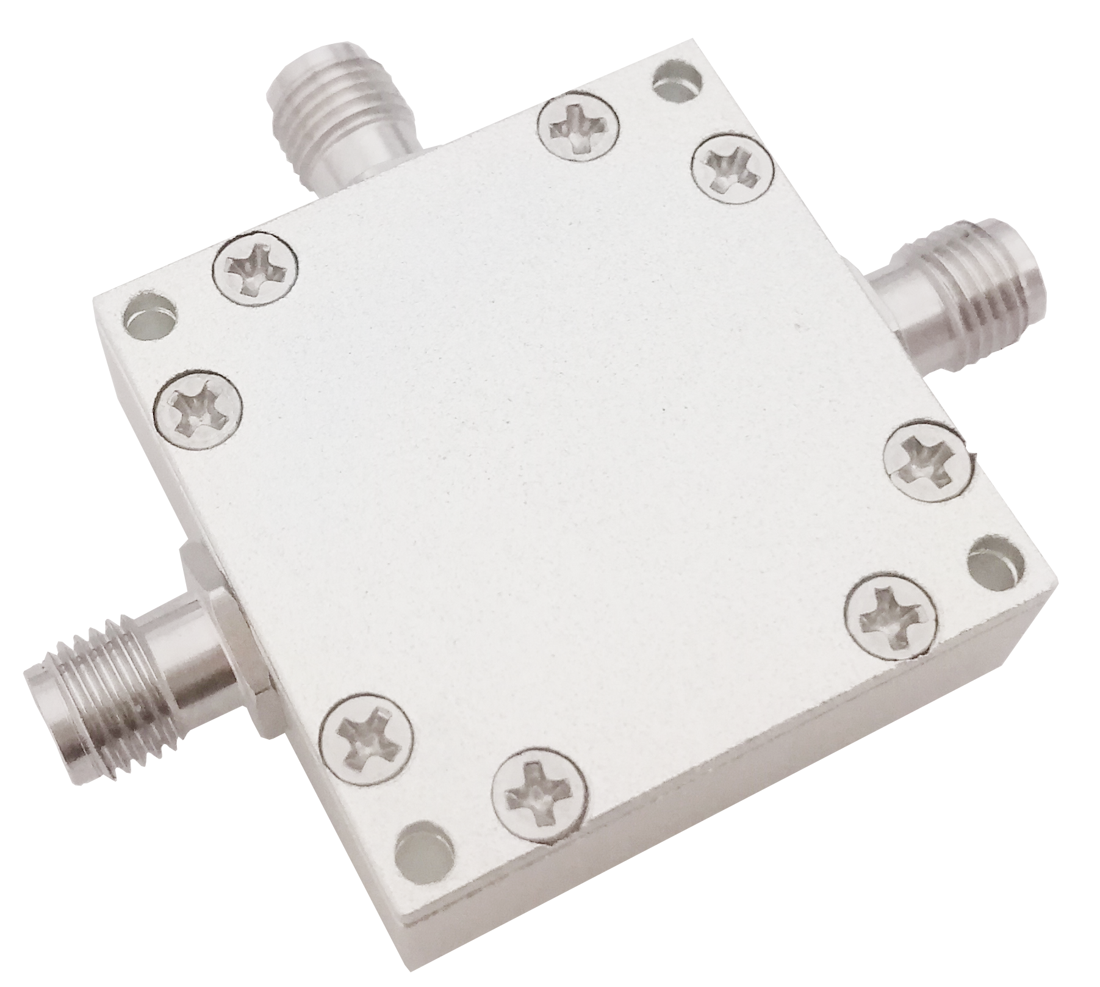
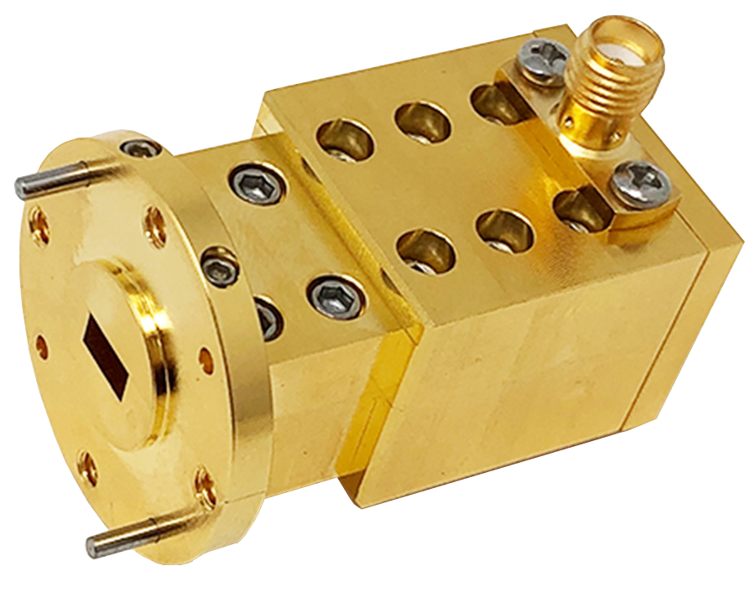
Mixers
Balanced Mixer
Harmonic Mixer
Freq. : 1KHz ~ 110GHz
Mixers
Balanced Mixers
Harmonic
Mixers
IQ Mixers

Slide 24
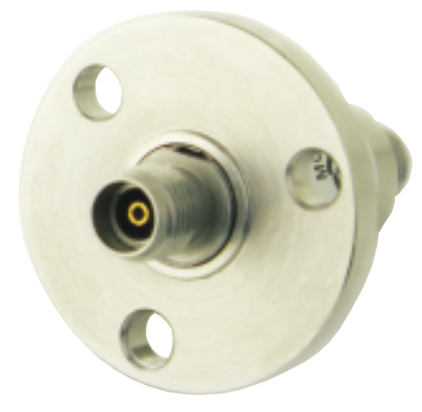
Rotary Joints
Freq. : up to 50GHz
Single Channel & Multi-Channels Available
Electrical Channels Optional
Waveguide is available
Rotary Joints

Slide 25
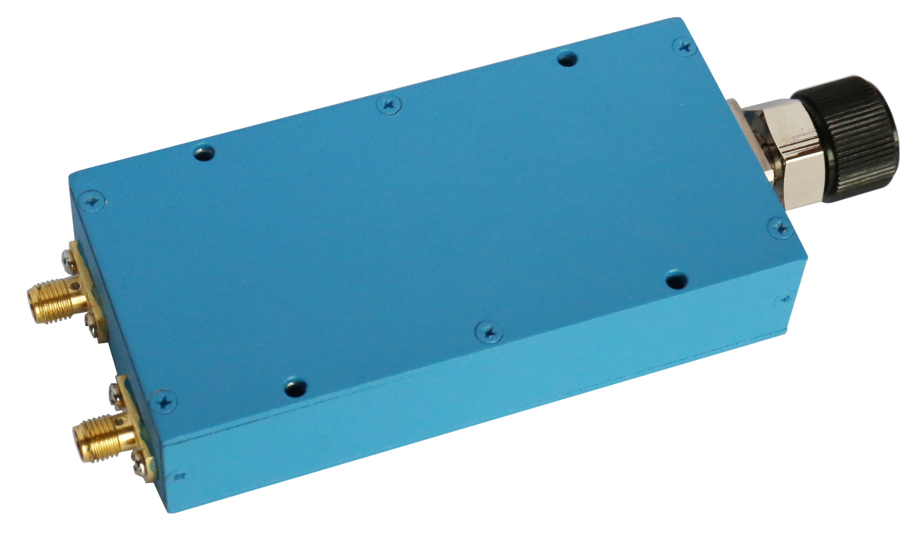
Phase Shifters
Manual Phase Shifters:
Up to 40GHz | Up to 900°/GHz | Up to 100W
Digitally Controlled Phase Shifter:
Up to 40GHz
Voltage Controlled Phase Shifter:
Up to 40GHz
Waveguide Manual Phase Shifter
Phase Shifters
Manual Phase Shifters
Digital Phase Shifters
Voltage Controlled Phase Shifters

Slide 26
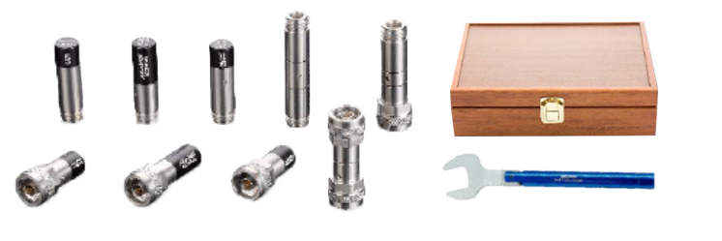
Calibration Kits
Freq.: Up to 67GHz
VSWR: ≤1.15 @40GHz,1.06@26.5GHz
Waveguide calibration kit is available
Connectors
7
mm
1.85
mm
2.4
mm
2.92
mm
3.5
mm
L16
N

Slide 27
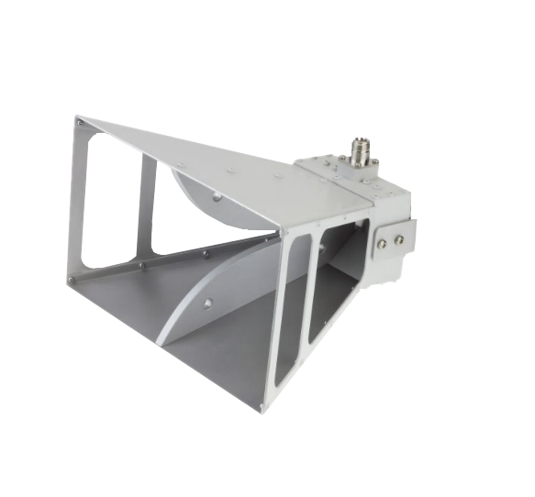
Antennas
Freq.: Up to 116GHz
Customization is available
Antennas
Rectangular Horn Antennas
Double Ridged Horn Antenn
Conical Horn Antennas

Slide 28
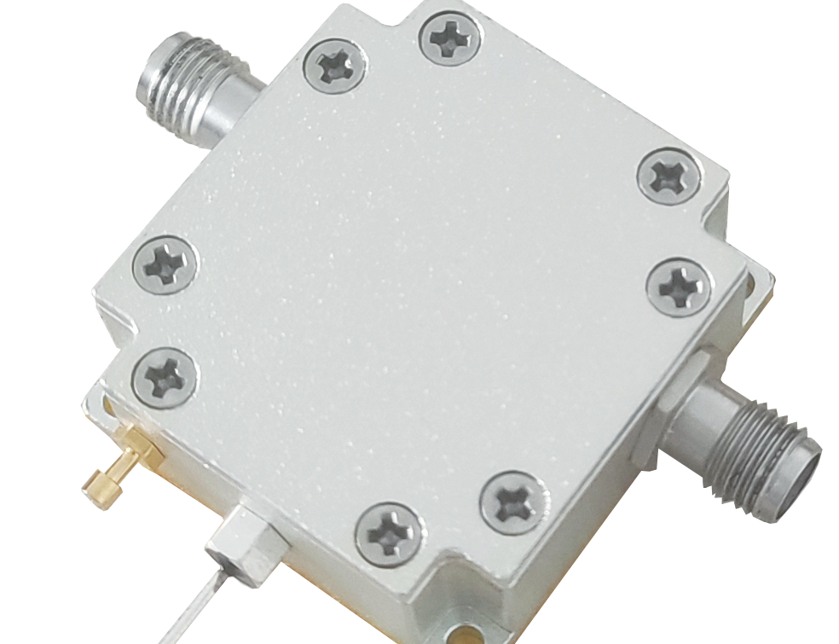
Other Products
Bias Tee: 0.005~40GHz
Frequency Multipliers: up to 110GHz
Frequency Dividers: up to 110GHz
Equalizer: up to 40GHz
* Customization is available
Other Products

Slide 29
Contact us
#1680, 1st Section of East Jinggong Road, Tianfu New Area, Chengdu, 610213, China
ADDRESS
E-MAIL
sales@freflex.com
WEB
www.freflex.com

